Slide 1
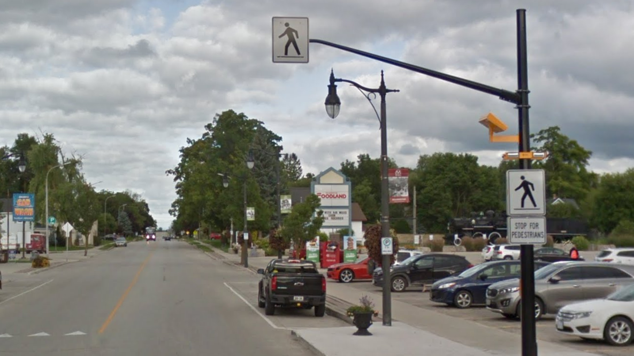


Community Safety Zone Reviews
Wellington County Roads Committee
January 11, 2022
Notes:
To add an image that automatically fills the background, select the rectangle labelled “click icon to add picture”
From the menu bar at the top select Insert>Pictures and navigate to a desired image and press “insert”
The image may be placed in front of the logo in the bottom right. To keep it in the background, right click the image and select send to back>send to back

Slide 2



Agenda
Overview
Approach
Corridors Assessed
Community Safety Zone Scoring
Community Safety Zone Recommendations
Discussion

Slide 3
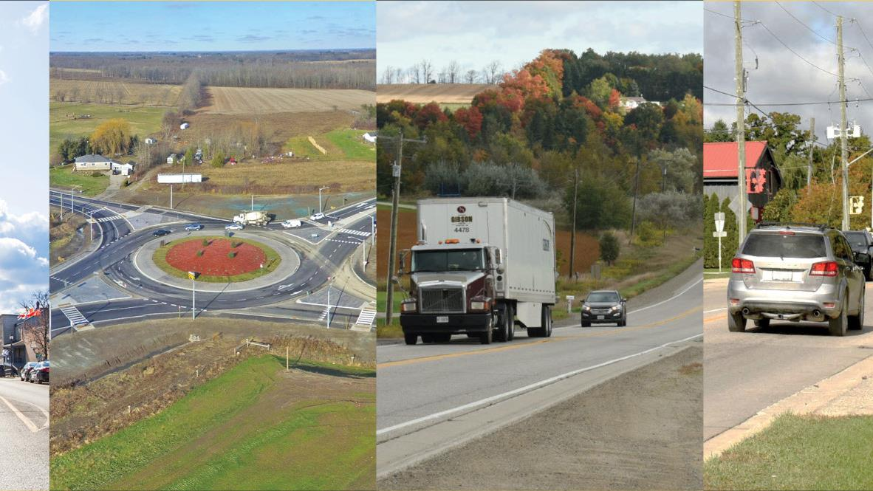
Overview

Slide 4
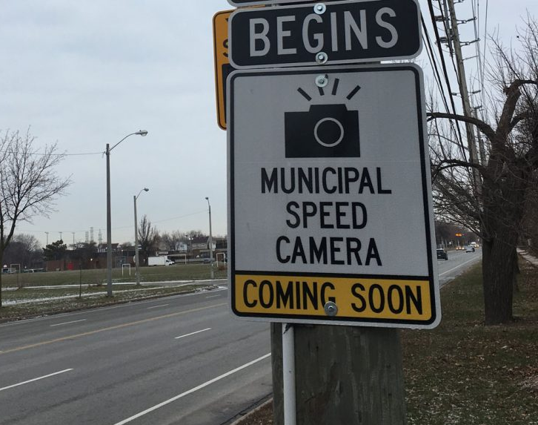
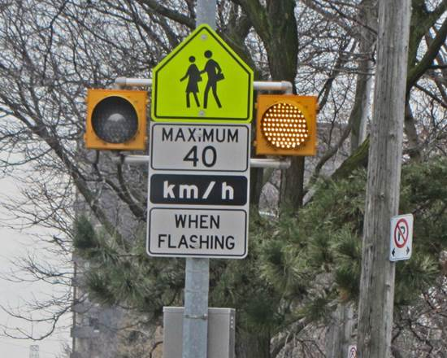
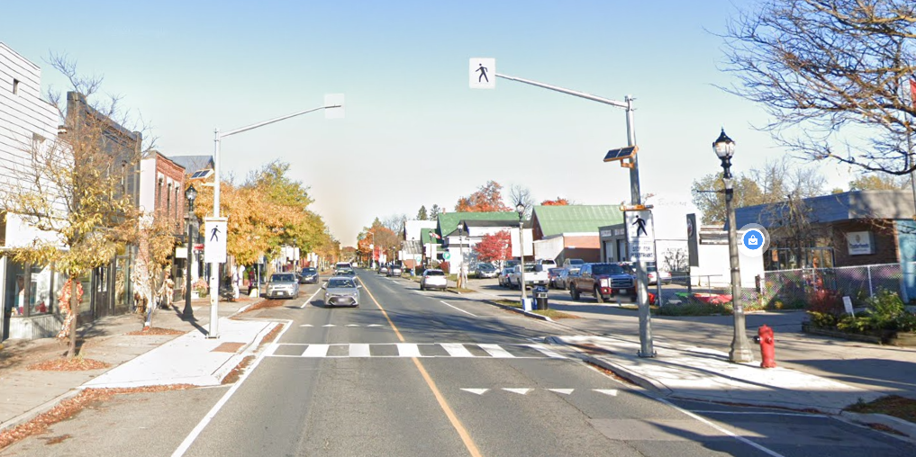
Overview
Speed Management Options
Regulatory Modifications:
  Speed Limit Adjustments
  School Zones
  Community Safety Zones (CSZs)
  Automated Speed Enforcement (ASE)
Geometric Modifications:
  Cross-Section Adjustments
  Traffic Calming
  Pedestrian Crossovers (PXOs)
Education Campaigns & Enforcement
Do Nothing
Notes:
Use this slide for smaller lists or when writing out one or two larger points, or a single graph or table
E.g. Agendas, lists of topics, Categories

Slide 5
Overview – Community Safety Zone Scoring
Methodology and scoring noted in the approved Speed Management Guidelines (September 2021)
Eight risk factors in the scoring:
Risk Factor | High (Score 3) | Medium (Score 2) | Low (Score 1)
Posted Speed (km/h) | 40 | 50 | 60
Average Daily Traffic Volume | >10,000 | 5,000 – 10,000 | <5,000
Number of Lanes (Both Directions) | >4 | 3 or 4 | 2
Presence of Community Facilities | School / Park (with playground) | Retirement Areas / Community Centre / Park (no playground) | None
Presence of Sidewalks | None | On one side | On both sides
Truck Volumes (as %) | >10% | 5 – 10% | <5%
Pedestrians Crossing (8 hrs) | >25 | 10 – 25 | <10
Intersections / Entrances (per km) | >10 | 4 – 10 | <4

Slide 6
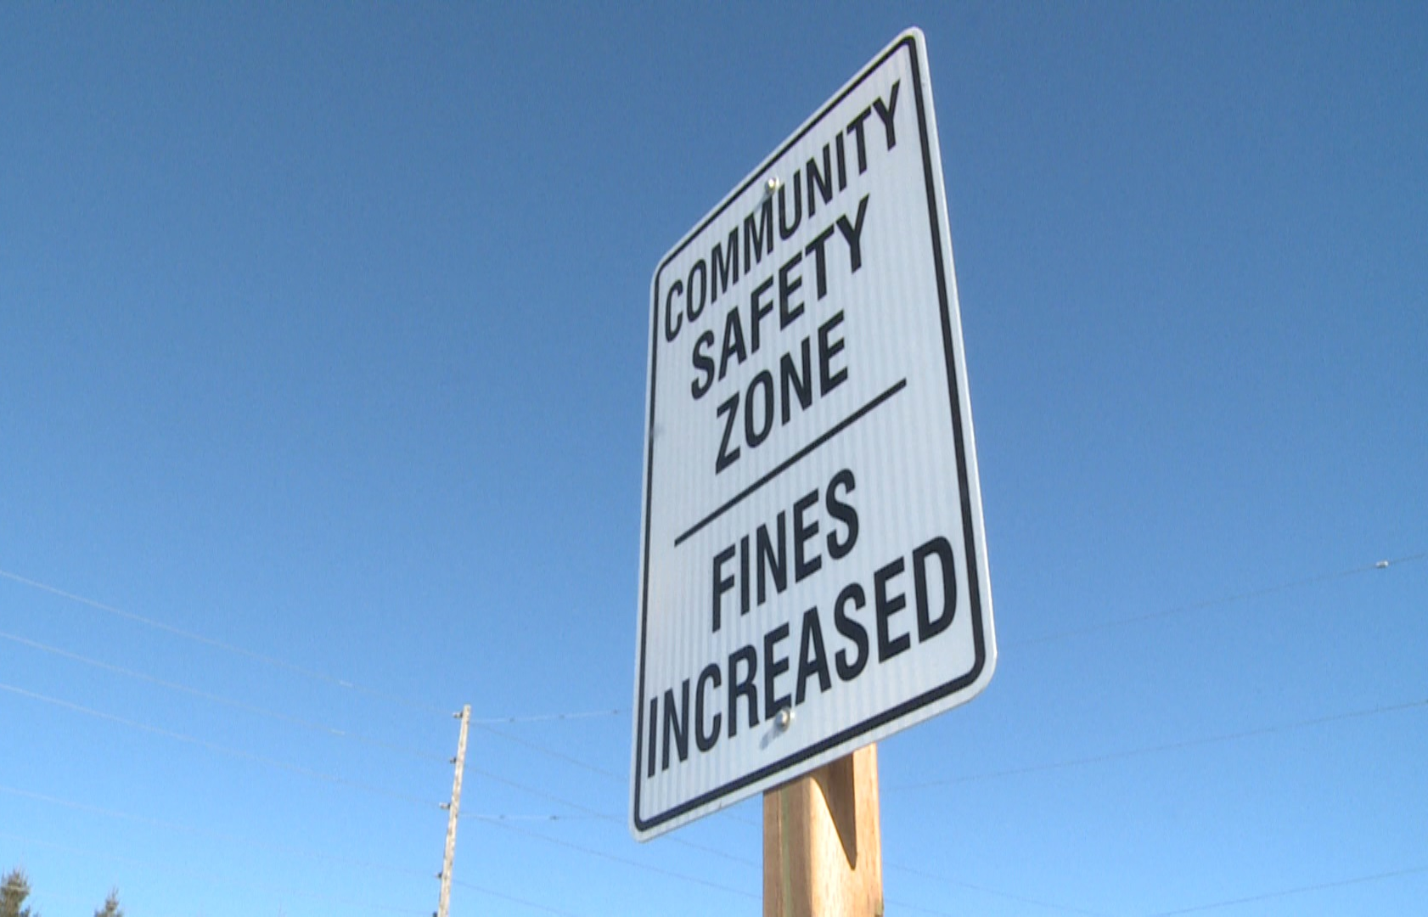
Scoring – Community Safety Zone Scoring
Scores from each of the eight factors are scored and totaled with the following actions taken:
Designate as a Community Safety Zone: 18 or more points are awarded
Staff to confirm if a Community Safety Zone is appropriate: 17 points are awarded and at least 3 categories are found to be high-risk
Community Safety Zone Not Warranted: Less than 17 points awarded, or 17 points with 2 or less categories that are high-risk

Slide 7
Overview – Communities Assessed
County Road corridors within 12 primary urban centres
and two secondary urban centres:
  Clifford (Wellington Road 2)
  Harriston (Wellington Road 109)
  Palmerston (Wellington Roads 5, 8 and 123)
  Mount Forest (Wellington Road 6)
  Arthur (Wellington Road 14)
  Moorefield (Wellington Road 10)
  Drayton (Wellington Roads 8 and 11)
  Elora/Salem (Wellington Roads 7, 18 and 21)
  Fergus (Wellington Roads 18 and 19)
  Hillsburgh (Wellington Road 24)
  Erin (Wellington Road 124)
  Rockwood (Wellington Roads 27 and 50)
  Aberfoyle (Wellington Roads 34 and 46)
  Morriston (Wellington Road 36)
No corridors that are currently identified as a provincial highway were assessed.
Scoring was initially undertaken by Dillon and then reviewed, updated and confirmed by Wellington County Roads staff

Slide 8
Community Safety Zone Scoring

Slide 9
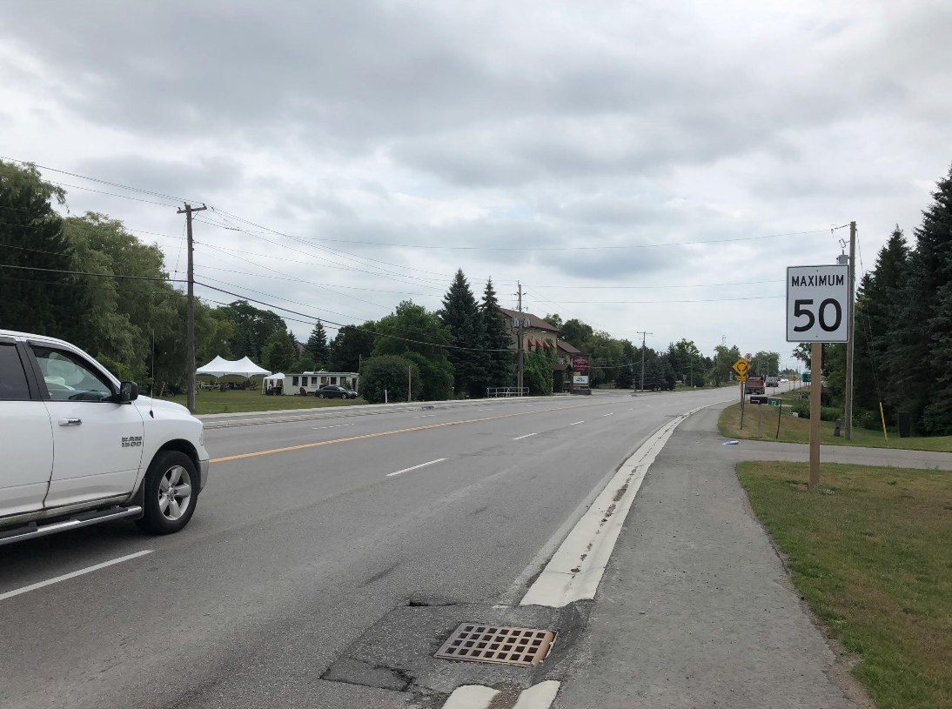
Technical Community Safety Zone Final Scoring (1 of 3)
Road Segment | Community | Total Score
Wellington Road 18 (Highway 6 - Orangeville Road) | Fergus | 19
Wellington Road 123 (Wellington Road 8 - Wellington Road 5) | Palmerston | 18
Wellington Road 11 (Andrews Drive - Wellington Road 8) | Drayton | 18
Wellington Road 7 (Ross Street - First Line) | Elora & Salem | 18
Wellington Road 24 (Church Street - Jane Street) | Hillsburgh | 18
Wellington Road 46 (Wellington Road 34 - Gilmour Road) | Aberfoyle | 18
Wellington Road 18 (Wellington Road 21 - Chapel Street) | Elora & Salem | 17
Wellington Road 124 (Ross Street - Wellington Road 52) | Erin | 17
Wellington Road 6 (Highway 6 - London Road) | Mount Forest | 17
Wellington Road 7 (Middlebrook Road - Ross Street) | Elora & Salem | 16
Wellington Road 18 (Beatty Line - Highway 6) | Fergus | 16
Wellington Road 109 (Arthur Street W. - Raglan Street W.) | Harriston | 16
Wellington Road 10 (Ball Avenue - Hilwood Drive) | Moorefield | 16
Wellington Road 46 (Gilmour Road - Highway 401) | Aberfoyle | 15
Wellington Road 11 (Wellington Road 8 - Mary Street) | Drayton | 15
Wellington Road 18 (James Street - Moir Street) | Elora & Salem | 15
Wellington Road 124 (Erin Park Drive - Ross Street) | Erin | 15
Wellington Road 46, Aberfoyle

Slide 10
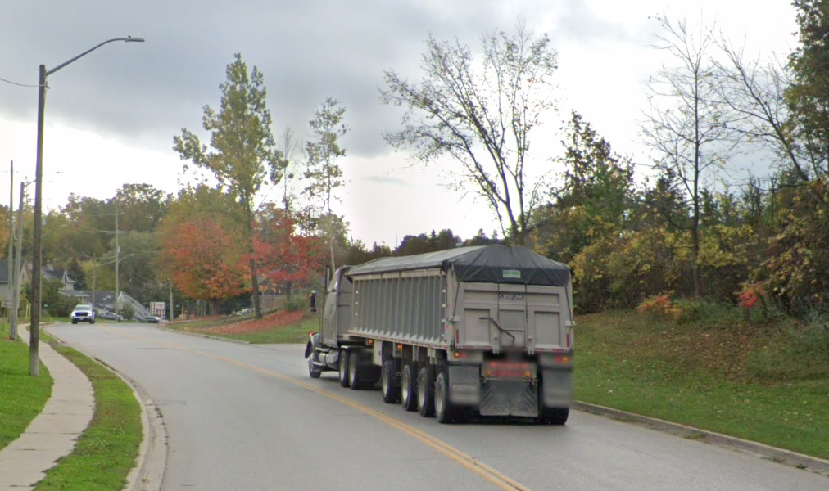
Technical Community Safety Zone Final Scoring (2 of 3)
Road Segment | Community | Total Score
Wellington Road 19 (Gartshore Street - Anderson Street) | Fergus | 15
Wellington Road 6 (Highway 89 - Highway 6) | Mount Forest | 15
Wellington Road 123 (Highway 23 - Wellington Road 8) | Palmerston | 15
Wellington Road 14 (Tucker Street - Domville Street) | Arthur | 14
Wellington Road 2 (Minto Street S. - Highway 9) | Clifford | 14
Wellington Road 18 (Moir Street - East Mill Street) | Elora & Salem | 14
Wellington Road 21 (Wellington Road 18 - Wellington Road 7) | Elora & Salem | 14
Wellington Road 7 (William Street - Middlebrook Road) | Elora & Salem | 14
Wellington Road 19 (Highway 6 - Gartshore Street) | Fergus | 14
Wellington Road 24 (Howe Street - Church Street) | Hillsburgh | 14
Wellington Road 8 (Mill Lane - Toronto Street) | Palmerston | 13
Wellington Road 5 (Lett Street - Wellington Road 123) | Palmerston | 13
Wellington Road 34 (Bull Frog Drive - Wellington Road 46) | Aberfoyle | 13
Wellington Road 8 (Drayton Industrial Drive - Wellington Road 11) | Drayton | 13
Wellington Road 18 (Wellington Road 7 - James Street) | Elora & Salem | 13
Wellington Road 52 (Wellington Road 124 - Ninth Line) | Erin | 13
Wellington Road 109 (Raglan Street W. - Jessie Street) | Harriston | 13
Wellington Road 10 (Concession Road 8 - Ball Avenue) | Moorefield | 13
Wellington Road 27 (Gzowski Street - Highway 7) | Rockwood | 13
Wellington Road 14 (Domville Street - Highway 6) | Arthur | 13
Wellington Road 7, Elora & Salem

Slide 11
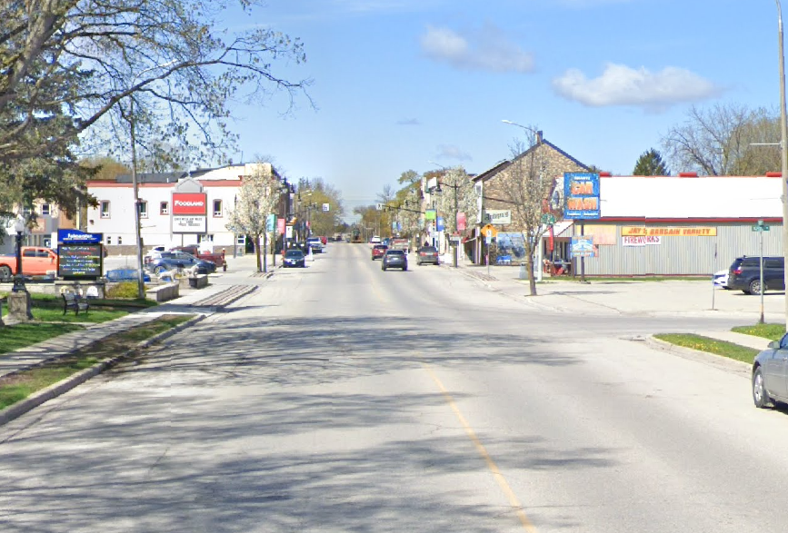
Technical Community Safety Zone Final Scoring (3 of 3)
Road Segment | Community | Total Score
Wellington Road 5 (Wellington Road 123 - Wellington Road 8) | Palmerston | 13
Wellington Road 2 (Highway 9 – Seip Lane) | Clifford | 12
Wellington Road 8 (Wellington Road 11 - John Street) | Drayton | 12
Wellington Road 8 (Wellington Road 123 - Mill Lane) | Palmerston | 12
Wellington Road 27 (Brebeuf Path - Gzowski Street) | Rockwood | 12
Wellington Road 2 (W Heritage Street - Allan Street W.) | Clifford | 11
Wellington Road 36 (Ochs Drive - Ochs Street) | Morriston | 11
Wellington Road 36 (Ochs Street - Highway 6) | Morriston | 11
Wellington Road 50 (Sammon Drive - Highway 7) | Rockwood | 11
  Six (6) corridors scored 18 or more points and recommended for a Community Safety Zone
  Three (3) corridors scored 17 points and featured 3
  high-risk categories and recommended for Staff to review and confirm Community Safety Zone designation
  Remaining corridors did not meet threshold
Wellington Road 123, Palmerston

Slide 12
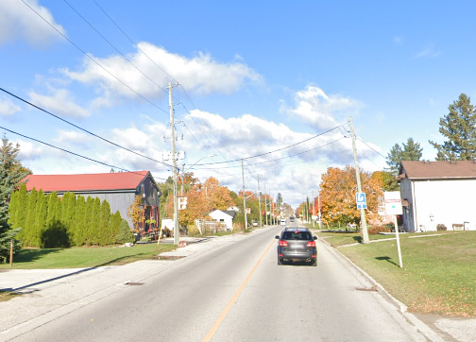
Community Safety Zone Scoring Summary
Six road segments received a score of 18 or above:
Fergus: Wellington Road 18 (Highway 6 - Orangeville Road)
Palmerston: Wellington Road 123 (Wellington Road 8 – Wellington Road 5)
Drayton - Wellington Road 11 (Andrews Drive - Wellington Road 8)
Elora & Salem - Wellington Road 7 (Ross Street - 1 Line)
Hillsburgh - Wellington Road 24 (Church Street - Jane Street)
Aberfoyle - Wellington Road 46 (Wellington Road 34 – Gilmour Road)
Three road segments received a score of 17 and at least three criteria were scored as high-risk:
Elora & Salem - Wellington Road 18 (Wellington Road 21 – Chapel Street)
Erin - Wellington Road 124 (Ross Street – Wellington Road 52)
Mount Forest - Wellington Road 6 (Highway 6 – London Road)
Wellington Road 24

Slide 13
Community Safety Zone Recommendations

Slide 14
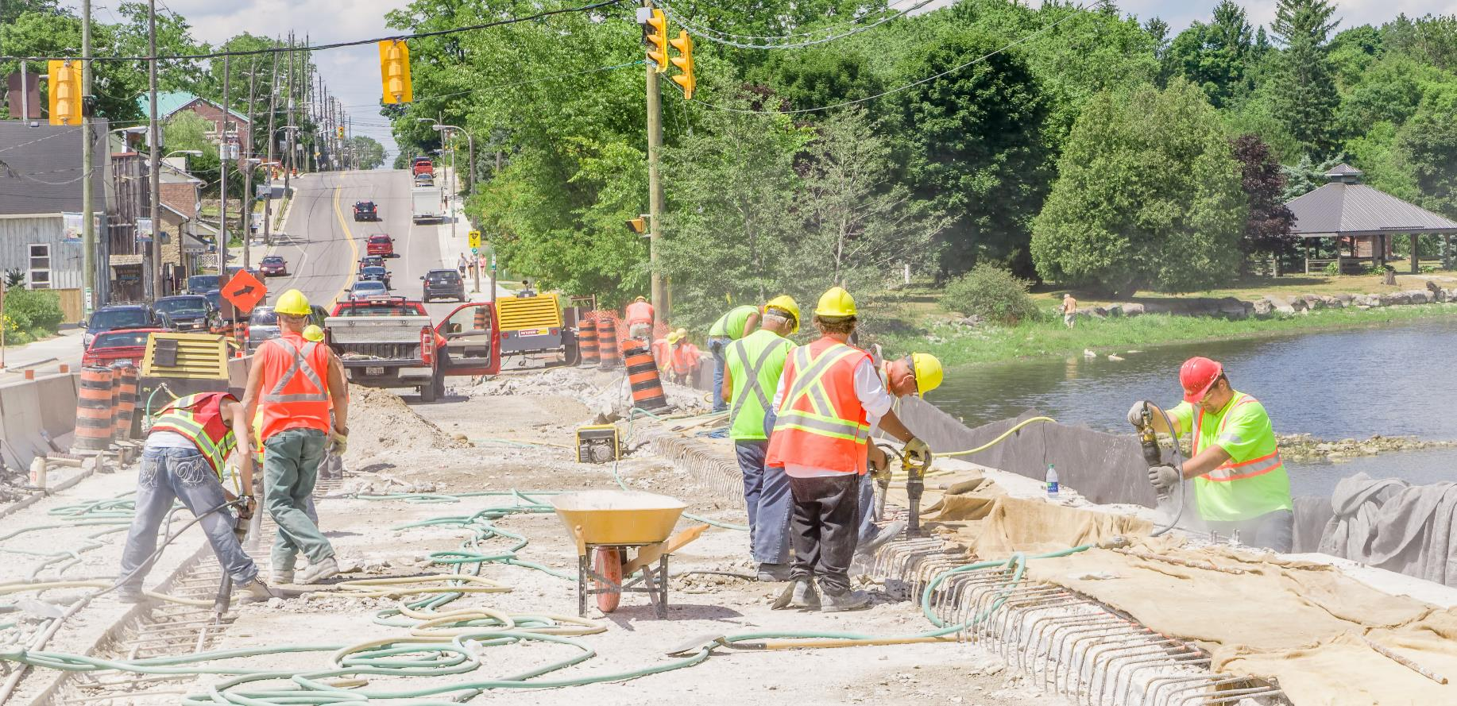
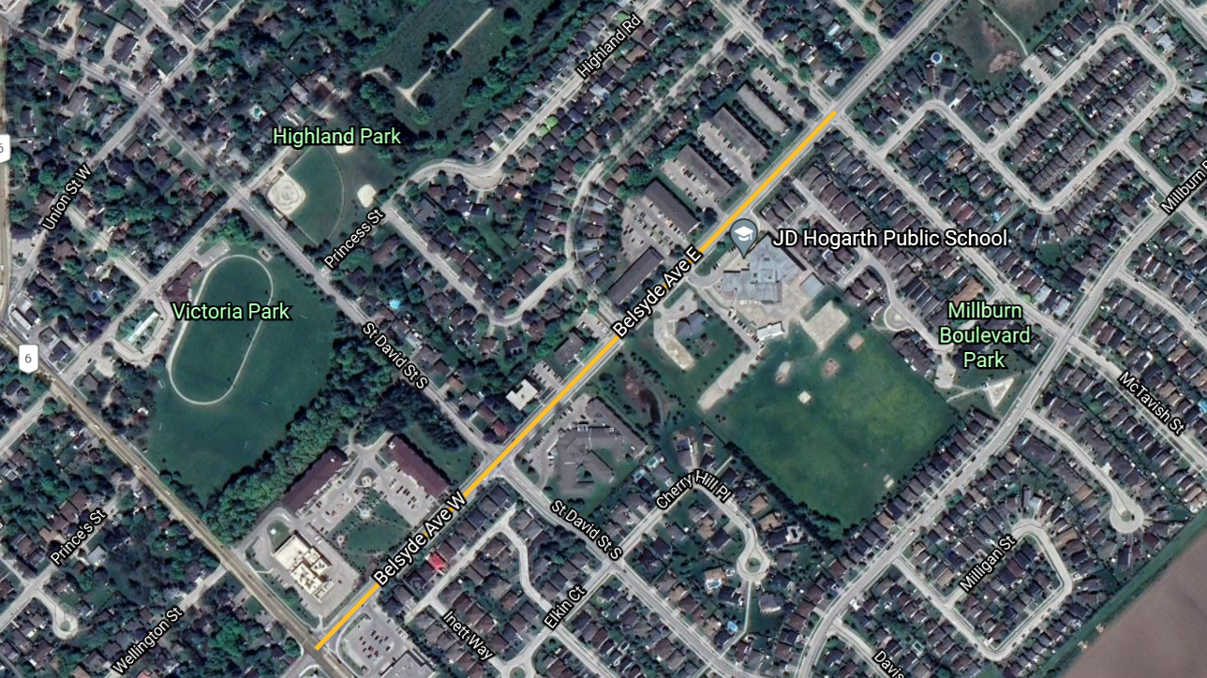
Community Safety Zone Recommendations (1 of 9)
Wellington Road 18 (Highway 6 – Orangeville Road), Fergus:
SCORE = 19
Recommend introducing a Community Safety Zone on Wellington Road 18 between Highway 6 and McTavish Street as this road section contains all of the sensitive community amenities.

Slide 15
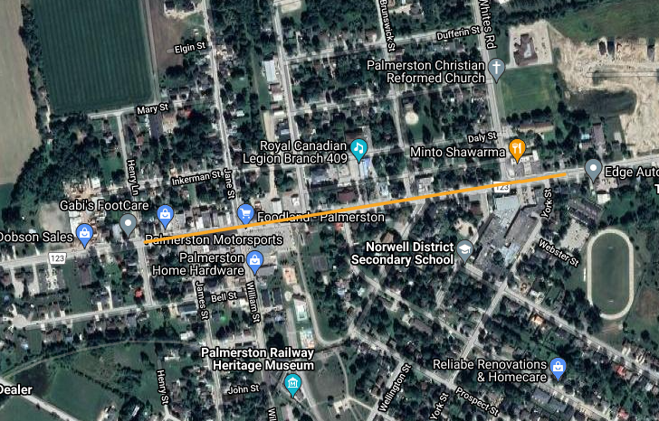
Community Safety Zone Recommendations (2 of 9)
Wellington Road 123 (Wellington Road 5 – Wellington Road 8), Palmerston:
SCORE = 18
Recommend introducing a Community Safety Zone along Wellington Road 123 from Henry Street east to York Street as this section includes all the more sensitive community amenities including the downtown limits, the park and secondary school.

Slide 16
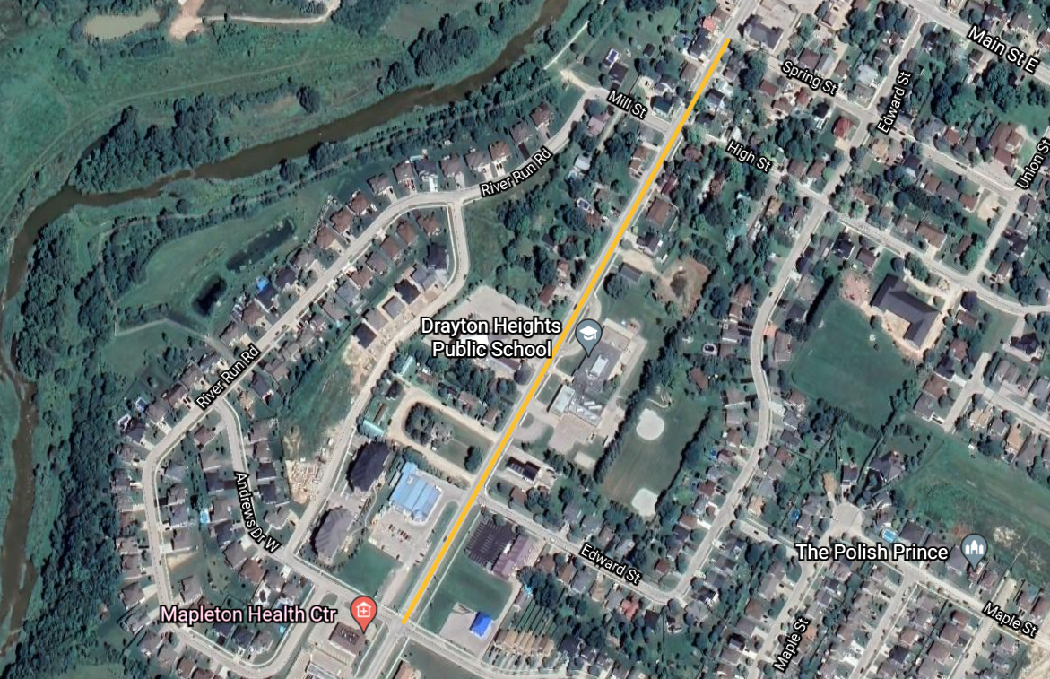
Community Safety Zone Recommendations (3 of 9)
Wellington Road 11 (Andrews Drive – Wellington Road 8), Drayton:
SCORE = 18
Recommend introducing a Community Safety Zone on Wellington Road 11 between Andrews Drive and Spring Street as this road section contains all of the sensitive community amenities (school and vertical grade).

Slide 17
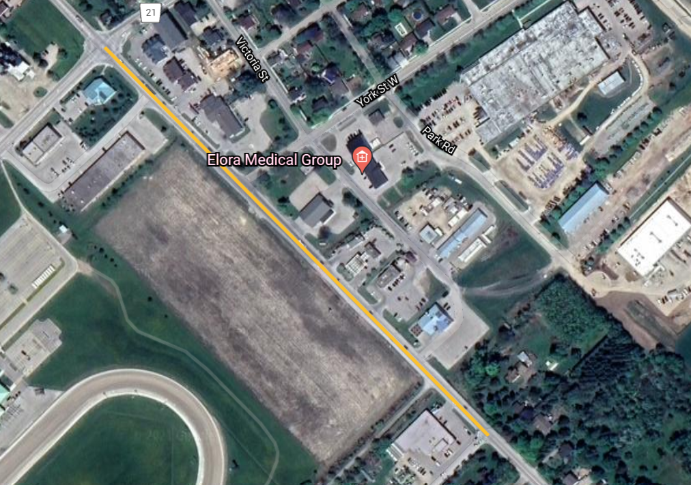
Community Safety Zone Recommendations (4 of 9)
Wellington Road 7 (Ross Street to First Line), Elora & Salem:
SCORE = 18
Recommend introducing a Community Safety Zone on the portion of Wellington Road 7 between Wellington Road 21 and Speers Road as this road section contains the major community amenities.

Slide 18
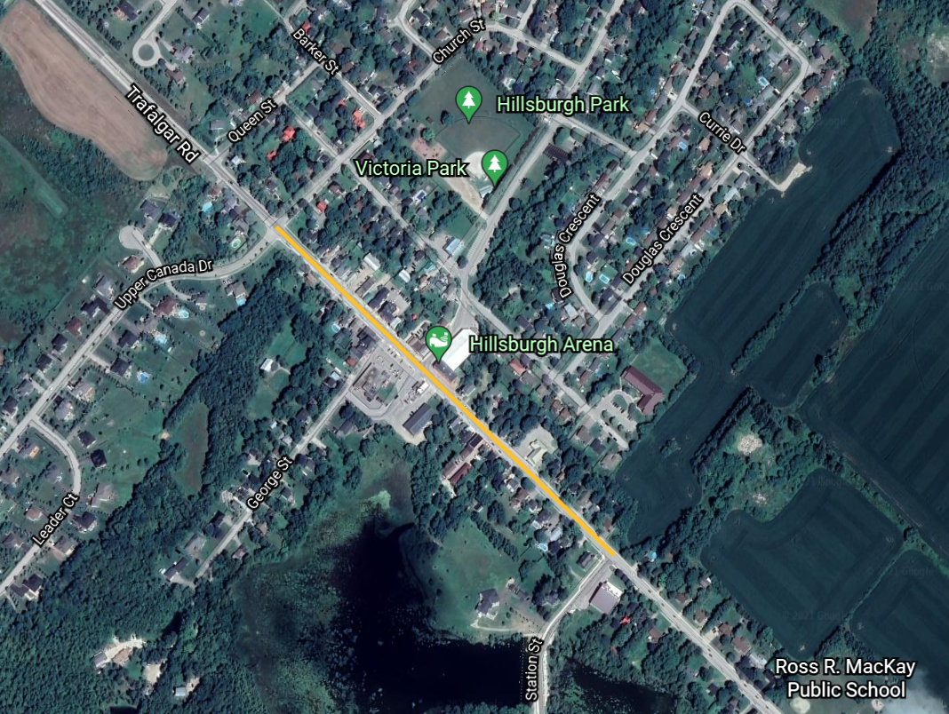
Community Safety Zone Recommendations (5 of 9)
Wellington Road 24 (Church Street to Jane Street), Hillsburgh:
SCORE = 18
Recommend introducing a Community Safety Zone on Wellington Road 24 between Church Street and Station Street as this road section contains the majority of the community amenities and has the most pedestrian traffic.
Alternative road safety measures were recommended surrounding the elementary school as part of the Speed Management Corridor Reviews.

Slide 19
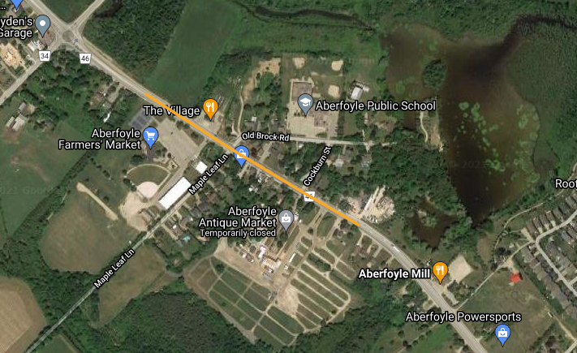
Community Safety Zone Recommendations (6 of 9)
Wellington Road 46 (Wellington Road 34 to Gilmour Drive), Aberfoyle:
SCORE = 18
Recommend introducing a Community Safety Zone on Wellington Road 46 through Aberfoyle both north and south of Old Brock Road.

Slide 20
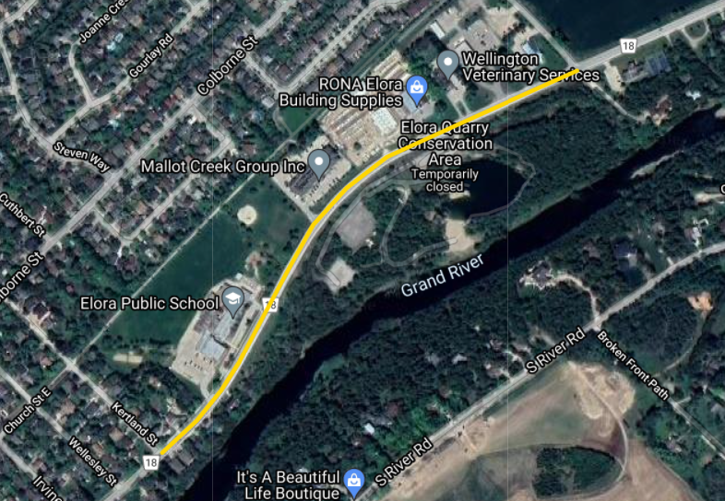
Community Safety Zone Recommendations (7 of 9)
Wellington Road 18 (Wellington Road 21 to Chapel Street), Elora & Salem:
SCORE = 17 (3 HIGH-RISK)
Recommend introducing a Community Safety Zone on a portion of Wellington Road 18 fronting the Elora Public School and the Elora Quarry Conservation Area.
The limits of this zone are recommended to be between Chapel Street and Kertland Street.

Slide 21
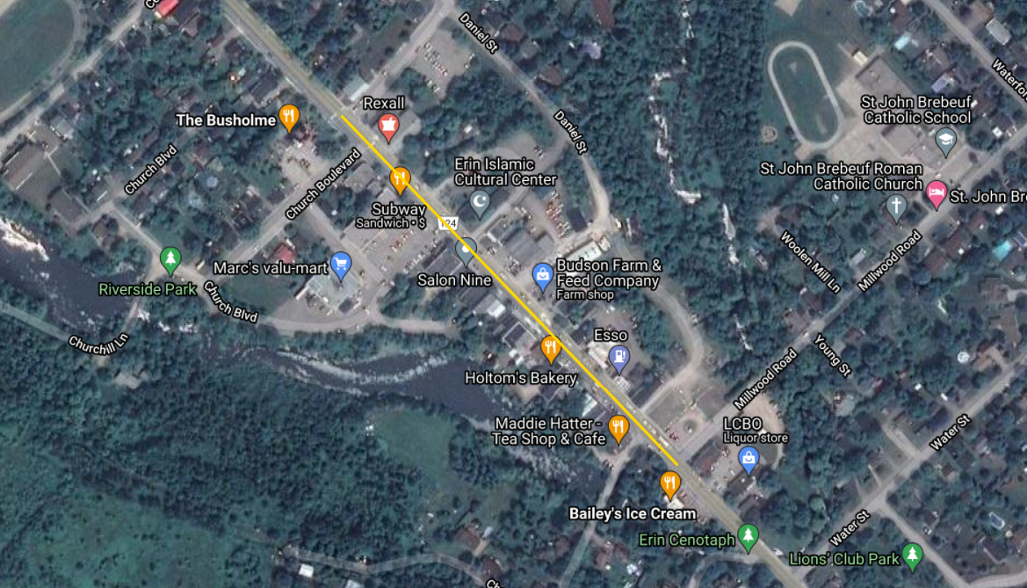
Community Safety Zone Recommendations (8 of 9)
Wellington Road 124 (Ross Street to Wellington Road 52), Erin:
SCORE = 17 (3 HIGH-RISK)
Recommend introducing a Community Safety Zone on a portion of Wellington Road 124 within downtown Erin.
The limits of this zone are recommended to be between East Church Street and Millwood Road.

Slide 22
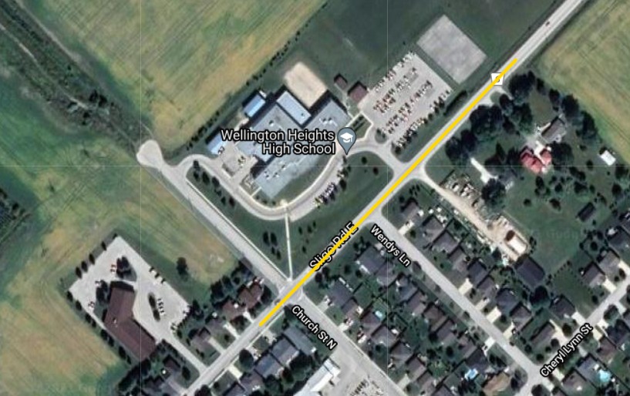
Community Safety Zone Recommendations (9 of 9)
Wellington Road 6 (Highway 6 to London Road), Mount Forest:
SCORE = 17 (3 HIGH-RISK)
Recommend introducing a Community Safety Zone on a portion of Wellington Road 6 fronting Wellington Heights High School.

Slide 23
Discussion

Slide 24
Thank You

