Slide 1
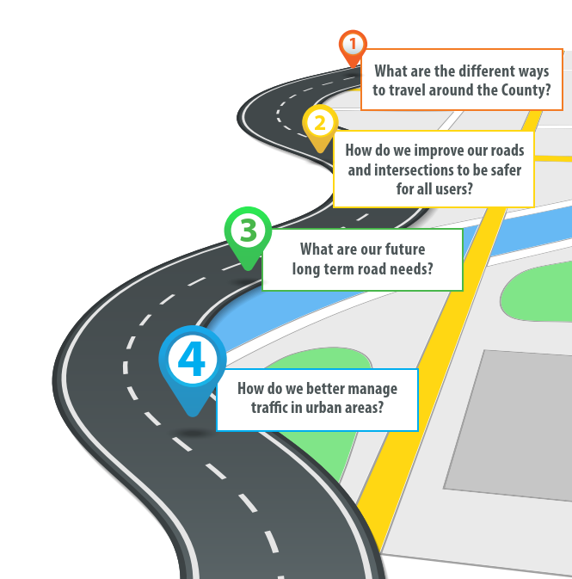


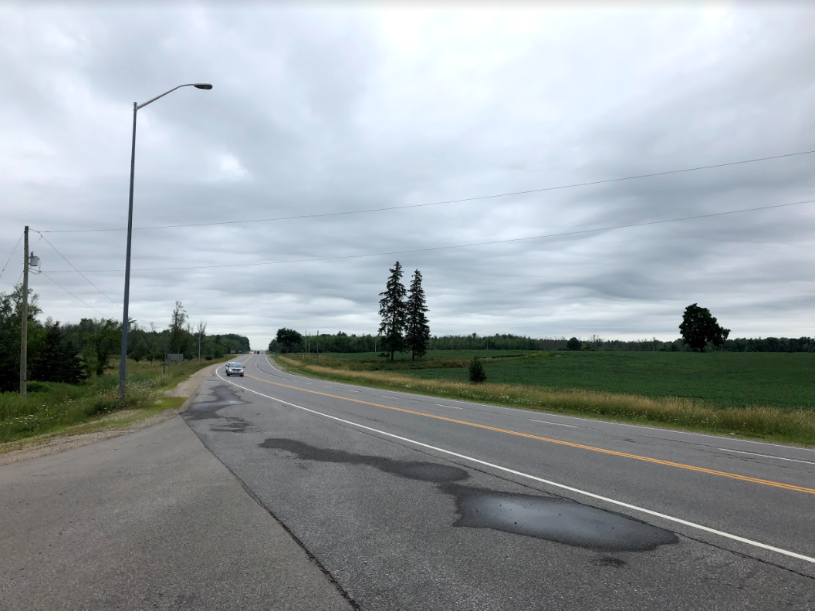
Wellington Road Master Action Plan
Final Report Presentation
Roads Committee Meeting
January 11, 2022
Notes:
To add an image that automatically fills the background, select the rectangle labelled “click icon to add picture”
From the menu bar at the top select Insert>Pictures and navigate to a desired image and press “insert”
The image may be placed in front of the logo in the bottom right. To keep it in the background, right click the image and select send to back>send to back

Slide 2




Agenda
Study Purpose
Approach and Key Recommendations
  MCEA and Engagement Review
  Vision and Goals
  Existing Conditions and Forecasted Growth
  Problem and Opportunity Statement
  Long-term Improvements
  Short-term Improvements
  Implementation Plan
Next Steps

Slide 3
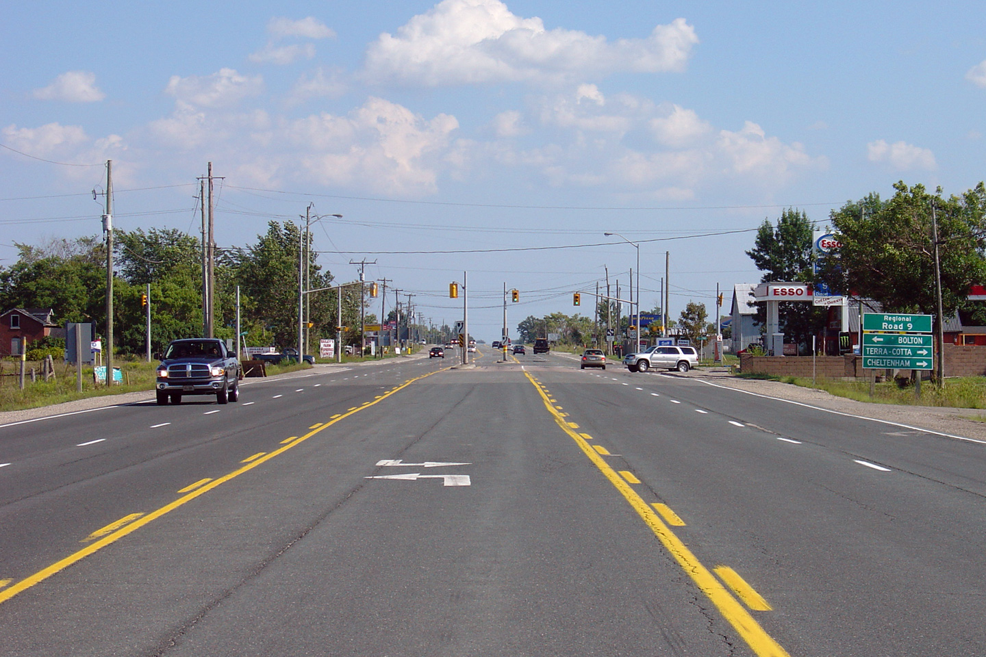

Study Purpose
Identify long-term County road network needs to support area growth
Provide input into other County plans and studies that will help make decisions on how to pay for improvements to the County road network
Identify and recommend measures to address concerns with the County roads including safety and speed
Identify opportunities to better connect the County to neighbouring municipalities and the broader region through an integrated transportation planning approach

Slide 4
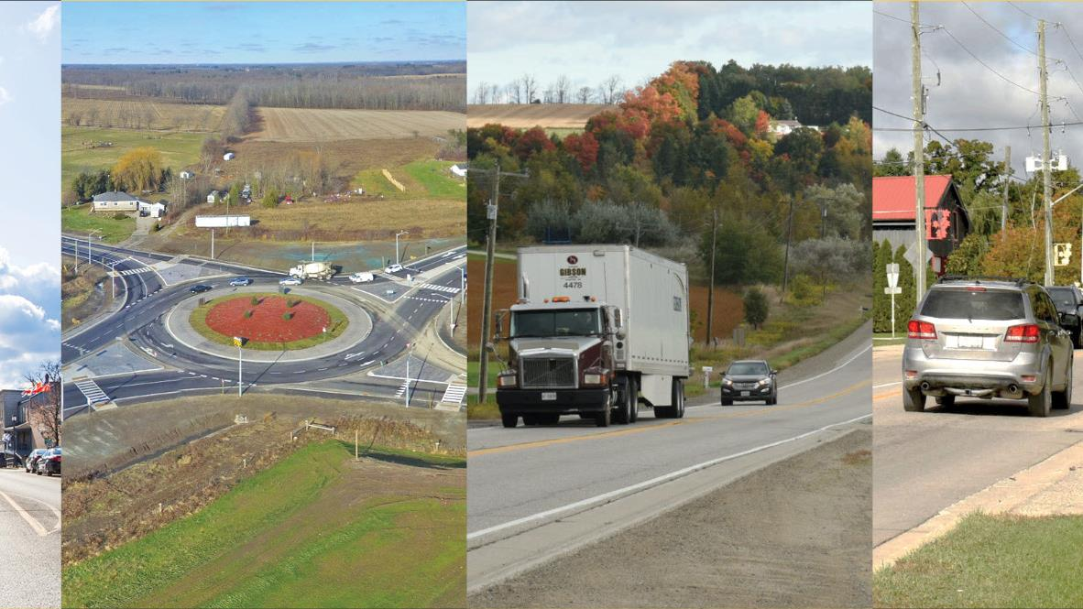
MCEA and Engagement Review

Slide 5
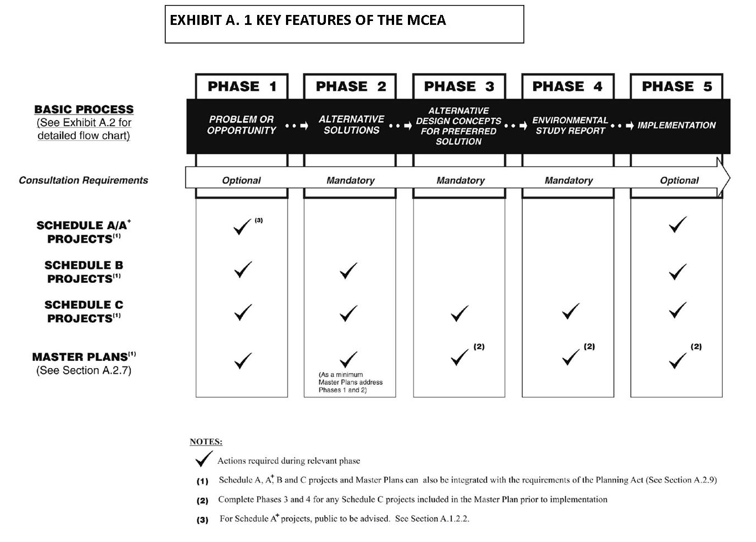
Municipal Class Environmental Assessment (MCEA) Process
The Master Plan is prepared at the conclusion of Phases 1 and 2 of the MCEA process
The Master Plan becomes the basis for, and used in support of, future investigations for the specific Schedule B and C projects identified within it
Notes:
Show map of class ea process and how it fits with this master plan
The RMAP was completed to satisfy the Class Environmental Assessment (EA) process in accordance with the master planning process for Municipal Class EAs.
The process is overseen by the Ministry of Environment, Conservation and Parks, and is designed to identify issues and opportunities that the Master Plan will focus on, design solutions, and chart a path forward for improvements to the road network across Wellington County.

Slide 6
Engagement and Timing
Project Initiation
TAG Meeting #1
Address Short-Term Operational Concerns
TAG Meeting #2
Long-Term Network Alternatives
Roads Committee Meeting #1
Implementation Plan
Roads Committee Meeting #3
Final Reporting
First Round Engagement
TAG Meeting #3
Roads Committee Meeting #2
Public Meeting
Roads Committee Meeting #4
Council Meeting
We are here
Sept
2020
Mar
2021
June
2021
Sept
2021
Dec
2021
Notes:
Roads Committee meetings
5 committee report updates
5 presentations
10 information reports

Slide 7


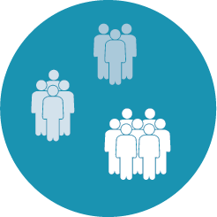
Engagement Summary
Roads Committee meetings
  5 committee report updates
  5 presentations
  10 information reports
Technical Advisory Group meetings
  3 meetings
  Representatives from all the local municipalities, Wellington OPP, MTO and the City of Guelph
Notes:
The engagement activities feed into the key decision points along the process, and for this Project were designed to go beyond the minimum requirements of the MCEA process.

Slide 8
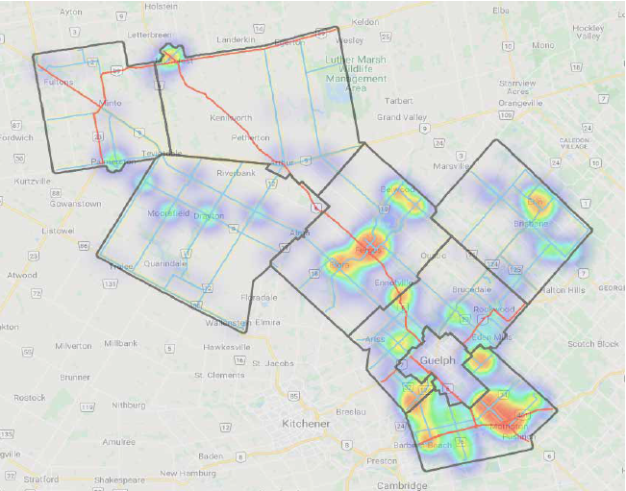


Engagement Summary
Engagement Round 1
  Online Survey #1: Vision and Values
    103 comments with 75% in support of the Vision
  Social Pinpoint Mapping Activity
    3,967 visits and 601 comments
Engagement Round 2
  Virtual PIC
  Online Survey #2:
    About 350 respondents participated
Notes:
The engagement activities feed into the key decision points along the process, and for this Project were designed to go beyond the minimum requirements of the MCEA process.

Slide 9
Vision and Goals

Slide 10


Vision and Goals
Vision
To connect people and goods across the County safely, conveniently, efficiently and sustainably
Goals
Create a Transportation Network with a Focus on Safety
Provide Sustainable and Equitable Mobility Options that Connect Communities
Be Proactive in Planning for Future Expansion of the County Road Network based on Complete Streets Principles while Considering the Quality of Life of Residents
Make Investment Decisions that are Environmentally Responsible
Support Economic Development
Be Fiscally-Responsible When Making Investment Decisions
Develop Transparent Policy Tools that Guide Investment Decisions in the Transportation Network
Create a Culture of Collaboration with Municipal Stakeholders where the County Transportation Network Intersects with Areas of Local Importance

Slide 11
Existing Conditions and Forecasted Growth

Slide 12

Existing Conditions and Forecasted Growth
Existing Context
Future Conditions
Primarily rural area with small urban centres
Primary mode of travel is personal vehicles
Long travel distances
Certain County Roads already approaching capacity
Speeding and safety concerns identified on a number of County Roads
Limited travel options for persons that do not have access to an automobile
Growing traffic volumes on County Roads through urban areas
Population will grow by 45% by 2041
Five corridors will be over capacity
County focus on safety and reducing transportation impact on climate change
Concerns that traffic growth will have on quality of life in urban areas

Slide 13
Problem and Opportunity Statement

Slide 14
Problem and Opportunity Statement
1. Address the future (2041) significant capacity constraints on portions of County Roads
Exceed Practical Capacity by 2041
(Significant Delay)
Wellington Road 7
  Between Elora/Salem and the Highway 6 junction
Wellington Road 18
  Between Wellington Road 21 (Elora) and Wellington Road 43 (Fergus)
  Wellington Road 18 between Elora and Fergus will experience Level of Service F
Wellington Road 32
  Between Wellington Road 124 and Highway 7, with Level of Service F
Wellington Road 46
  Between Maltby Road and Wellington Road 34, with Level of Service F
Wellington Road 124
  Between the Region of Waterloo boundary limits and the City of Guelph boundary limits
Approach Practical Capacity by 2041
(Moderate Delay)
Wellington Road 21
  Between Wellington Road 7 (Elora) and the Region of Waterloo boundary limits, with Level of Service E
Wellington Road 86
  Between Wellington Road 10 and Wallenstein, with Level of Service E

Slide 15

Problem and Opportunity Statement
Improve connectivity of the active transportation network
Identify opportunities to improve equitable mobility through expansion of transit
Reduce Greenhouse Gas emissions
Address short-term safety
and speeding issues

Slide 16
Long-term Improvements

Slide 17
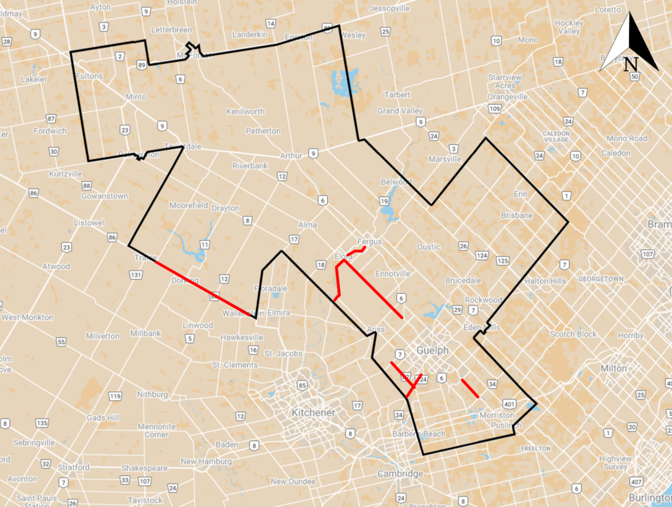
Long-term Transportation Needs (Methodology)
Transportation assessment undertaken to determine impact of growth on road network
Growth components
  External, non-County trips travelling through the network
  General population and employment growth to 2041
  Specific Secondary Plan developments (e.g. Clair-Maltby)
Account for planned long-term network improvements
  Hanlon Expressway improvements (MTO), including Morriston By-Pass
Capacity issues identified on seven roadway corridors – will approach or exceed practical capacity by 2041
Alternatives identified and evaluated for each of the seven corridors

Slide 18
Alternative Strategies to Address Network Deficiencies
Overview | Travel Demand Management (TDM) | Transportation System Management (TSM) | Increase the Supply of Infrastructure
Solutions Description | Modify travel behaviour and reduce vehicle use (shift to other modes) | Optimize infrastructure to improve performance Improve the quality of the roadway Use of technology Add turning lanes | Expand existing infrastructure Add new infrastructure
Anticipated Effectiveness to Address Capacity Issues | Low | Medium | High
Notes:
Don’t show detail for each corridor as this was already presented
Discuss any changes made as a result of engagement.

Slide 19
Evaluation Criteria
Factor / Criteria Group | Support Project Goals | Sub Factor / Criteria
Transportation | Focus on Safety Sustainable and Equitable Mobility Options Proactive Planning for Future Expansion based on Complete Streets Principles | Network Connectivity to Provincial Roads Network Connectivity/Service to Regional Area Network Connectivity/Service to Local Area Maintain/Enhance Capacity of network Safety - Collision Potential Support Movement of Goods Noise Impacts Support Active Transportation Residences Directly Impacted
Natural Environment | Investment Decisions that are Environmentally Responsible | Natural Hazard Areas Impacted Air Quality (Sensitive Receptors) Climate Change – Reduce GHG Species at Risk/Habitat Impacted Water Courses Crossed Woodlands and Woodlots Impacted Wildlife Habitats and Movement/Corridor Crossings Wetlands Impacted Provincially/Regionally Significant Wetland Impacted
Notes:
Discuss any Results from engagement
changes made as a result of engagement

Slide 20
Evaluation Criteria
Factor / Criteria Group | Support Project Goals | Sub Factor / Criteria
Cultural Environment | Culture of Collaboration Transparent Policy Tools that Guide Investment Decisions | Heritage Property or Buildings Impacted Impact to Heritage Landscape Features (fence rows, tree lines, etc.) Cemeteries Impacted Sites of Archaeological Potential Utility Corridors Impacted Potential for Ride Well (transit) and business partnership Compatibility with Provincial, County, and City policies and GRCA framework standards
Socio-Economic Environment | Support Economic Development | Farming Activity Impacted Businesses Impacted Existing Businesses and Industry and Opportunities for New Businesses and Industry – Access Opportunity for Communities to Draw New Businesses Support / Improve Tourism
Cost | Fiscally-Responsible | Capital Cost Operational and Maintenance Costs Funding opportunities through grant
Notes:
Results from engagement

Slide 21
Summary of Recommendations and Timing
Project | Limits | Improvements | Years
Wellington Road 124 | Region of Waterloo boundary and City of Guelph boundary | Maintain recommendation from approved WR 124 EA | 0 to 5
Wellington Road 18 | WR 21 (Elora) and WR 43 (Fergus) | Transportation Systems Management and Expansion of Infrastructure Restricted parking and centre left turn lane between Metcalfe Street and Kertland Street Additional lane per direction between Kertland Street and Canrobert Street Additional lane per direction between Highway 6 and WR 43 | 6 to 10
Wellington Road 46 | Maltby Road and WR 34 | Expand Infrastructure Additional lane per direction | 10 to 20
Wellington Road 7 | Elora/Salem and the Highway 6 Junction | Expand Infrastructure Additional lane per direction for road and bridge | 10 to 20
Wellington Road 21 | WR 7 (Elora) and Region of Waterloo | Transportation Systems Management Paving/widening shoulders | 10 to 20
Wellington Road 32 | WR 124 and Highway 7 | Transportation Systems Management Paving/widening shoulders Provision of auxiliary left turn lanes where necessary | 10 to 20
Wellington Road 86 | WR 10 and WR 85 | Transportation Systems Management Paving/widening shoulders Provision of auxiliary left turn lanes through Hamlet of Dorking | 10 to 20

Slide 22
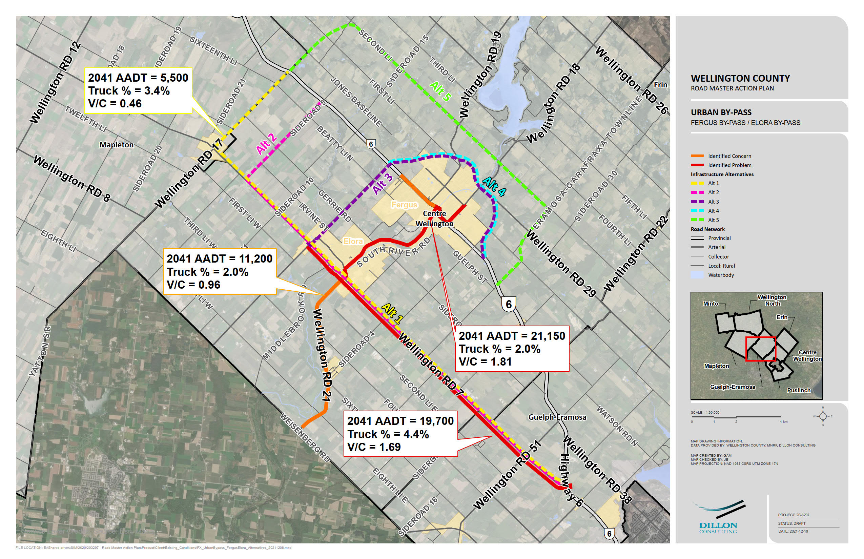
By-pass Assessment
Problems identified in the Elora/Fergus area on WR 7, WR 18 and Hwy 6
Several alternatives were assessed, and new alternatives added based on public feedback
Alternatives included those previously identified in Centre-Wellington Transportation Master Plan
Involvement of three jurisdictions in a sub-area requires a more focused area transportation study to identify opportunities and impacts to the community
Notes:
Paul speaking notes: Eigth Line was was noted in the report as an Alternative to WR 7 but it was not included in the bypass assessment section and map. Maybe a general comment in the presentation would be that other alternatives could be reviewed as part of the Area Wide Study

Slide 23


Active Transportation
Build on the County of Wellington Active Transportation Plan (ATP)
Key Recommendations:
  For each recommended road improvement, pave any gravel shoulders during construction
  Shoulders should be 2.5 to 3 m wide with a delineated edge marking
  Add to active transportation facilities in the Active Transportation Plan
Addresses the RMAP Goals of Safety, Equitable Mobility and Complete Streets

Slide 24
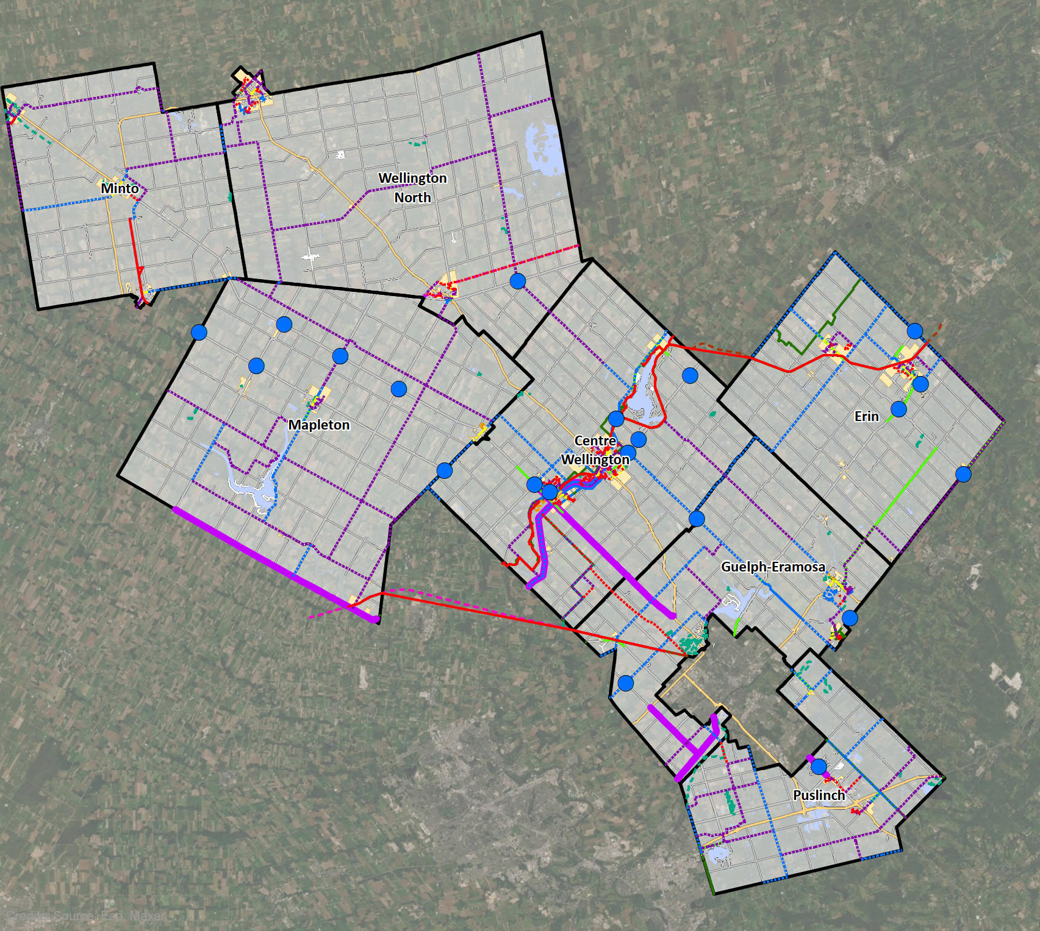
Active Transportation
1. Pave gravel shoulders with roadway improvement and designate as Active Transportation corridor:
WR 7 between Elora/Salem and Highway 6 junction
WR 21 between WR7 and Region of Waterloo
WR 32 between WR124 and Hwy 7
WR 124 between Region of Waterloo and City of Guelph
WR 86 between WR 10 and WR 85
WR 46 between Maltby Road and WR 84
2. Maintain and enhance paved shoulder for cyclists with road improvement
WR 18 between WR 21 and WR 43
Notes:
For each of the recommended road improvements, it is recommended that any gravel shoulders are paved during construction. While shoulders are intended to accommodate emergency vehicles and provide refuge for passenger vehicles during mechanical or other user emergencies, shoulders can provide sufficient operating space for non-motorized vehicles.

Slide 25

Transit
Existing Context
Importance of Transit
Primary objective to improve equitable mobility by providing service to all residents in the County
Ride Well began in 2019
Ridership steadily growing, but still below typical rural systems
Provincial funding set to expire in 2025
Need to make a decision on whether transit should be permanent
Many newcomers used to transit
Supports and aging population
Supports economic development (existing challenge attracting workers that don’t have access to a vehicle)
Provides mobility for youth
Moves towards equitable mobility options for all residents

Slide 26
Transit Options Assessed
[DK1]Wording?
RMAP Goal | Dedicated On Demand Service (e.g. Ride Well) | Non-Dedicated On Demand Service (e.g. Uber) | Dedicated Fixed-Route Service (e.g. Denny Bus) | Community Care Partnerships (e.g. VON)
Description | Existing Ride Well service providing demand-responsive service to everyone in the County | Partner with taxis or ridesharing, primarily focused in the south | Corridor service on a schedule connecting urban hamlets | Provide funding to community care for seniors and persons with disabilities
Goal 1: Focus on Safety |  |  |  | 
Goal 2: Sustainable and Equitable Mobility Options |  |  |  | 
Goal 4: Decisions that are Environmentally Responsible |  |  |  | 
Goal 5: Support Economic Development |  |  |  | 
Goal 6: Be Fiscally-Responsible |  |  |  | 

Slide 27
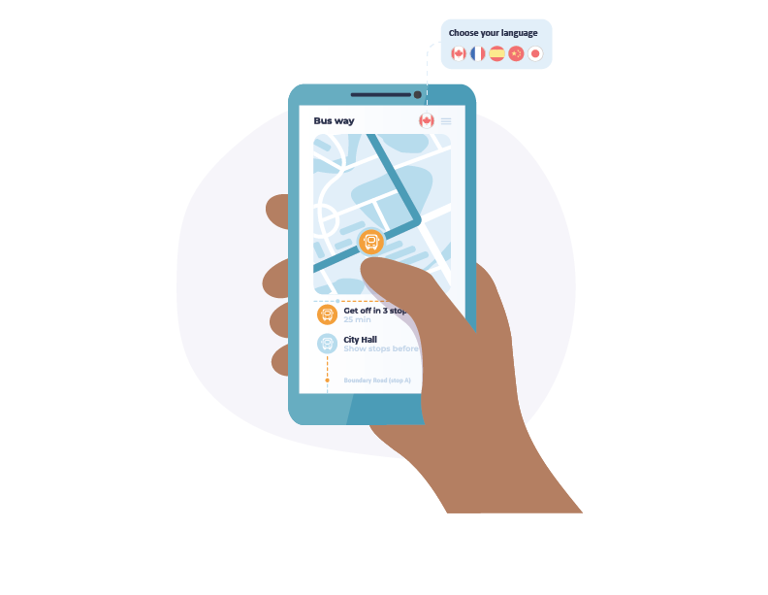
Transit Recommendations
Short-term Recommendations
Continue to operate and expand Ride Well service as ridership grows
Integrate Ride Well with fixed-route services (GOST service from Owen Sound and the Denny Bus Line Service)
Set a maximum cap on fares to make the service more affordable,
Purchase accessible vehicles through capital funding grants
Long-term Recommendations
Establish fixed-route service on Highway 6
Integrate On Demand trips with fixed-route corridor
Continue to expand the On Demand service model based on ridership demand
Initiate Partnership with Non-Dedicated Providers
Continue Coordination with Community Care Agencies
Connect to fixed-route services between Guelph and the Region of Waterloo

Slide 28

Climate Change
County’s Climate Mitigation Plan focuses on climate change mitigation, specifically the reduction of greenhouse gas (GHG) emissions
Transportation accounts for 70% of GHG emissions from fossil fuels in the community
Recommendations in RMAP will not see a dramatic shift in more sustainable modes to off-set GHG emissions due to the rural nature of County
Climate change focus is to transition to the use of more zero-emission vehicles (ZEV)

Slide 29
Climate Change – Summary of Recommendations
Zero-Emission Vehicle (ZEV) Adoption
Start with the County's fleet (snow plows, maintenance vehicles, Ride Well)
Communicate financial and regulatory incentives
Seek funding to support infrastructure
Develop new policy tools and by-laws for development approval process
Provide incentives (priority parking for ZEV vehicles)
Improve ZEV’s infrastructures and build charging network
Increase public awareness of ZEV
Other Actions to Reduce Climate Change
Improve transit service and increase efficiency along key corridors
TDM strategies to reduce single occupant vehicle travel
Adopt low GHG road construction and maintenance techniques
Marketing and communication opportunities
Undertake a Climate Change Adaption Plan

Slide 30
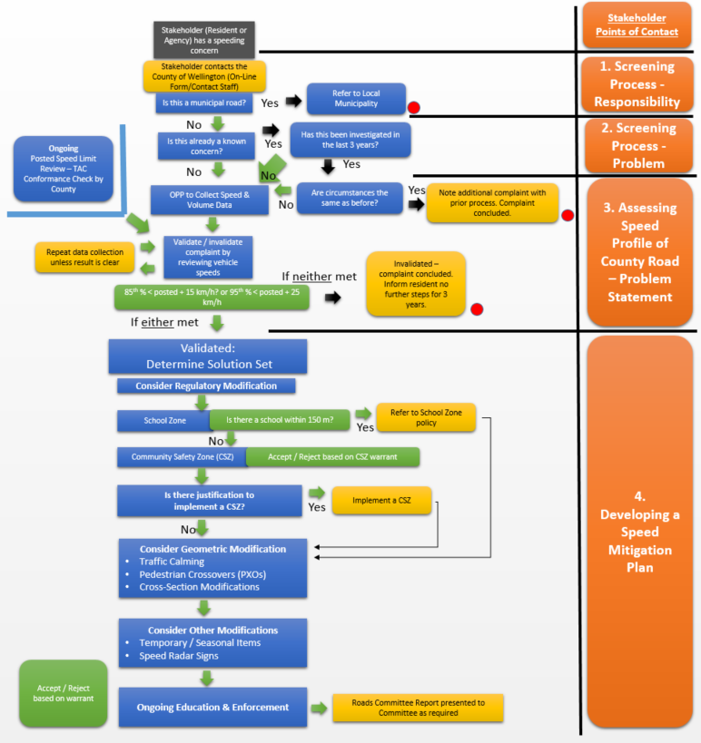
Policy Framework
Goal to improve transparency in decision making
Strategic policies and assessments developed and approved as part of the RMAP include:
  Data Driven Safety Strategy (approved)
  Speed Management Guidelines (approved)
  Traffic Impact Study Guidelines (approved)
  Update to Official Plan Policies
  Level of Service Conditions Criteria
  WR 46 Strategic Traffic Analysis
  Urban Area By-Pass
Sample from Speed Management Guidelines
Notes:
Explain purpose of each of these documents in presentation.

Slide 31
Short-term Improvements

Slide 32
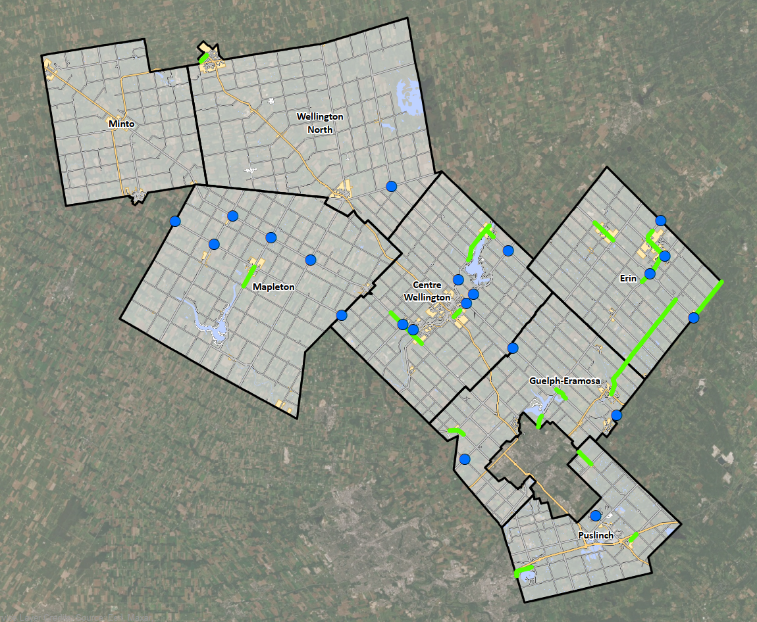
Short-term Operational and Safety Improvements
Roadway Safety and Speed Management
  Reviewed 16 corridors using approved Speed Management Guidelines
Intersection Assessment
  Conduced geometric and safety review of 22 intersections corridors using approved speed management guidelines
Recommendations made in each to be reviewed by County staff with improvements individually brought to Committee and Council

Slide 33
Implementation Plan

Slide 34
Implementation Plan - Short-Term Capital Cost Estimates (0 to 5 years)
Project | Description | Costs
Wellington Road 124 | Improvements will be as per recommendations from approved WR 124 EA between Region of Waterloo boundary limits and City of Guelph boundary limits | $15,800,000
Operational Improvements | Annual project expense for Intersection improvements and speed management initiatives¹ | $10,600,000
Transit | Purchase three to four accessible Ride Well vehicles and lease to operator (assumed 80% covered through Grant Funding) | $48,000
Planning Studies | 1. WR 46 Area Study ($50,000) 2. WR 46 EA Study ($500,000) 3. Fergus/Elora Area Study/By-Pass Feasibility Study ($100,000) | $650,000
Total | Estimated total of short-term costs | $27,098,000
¹ Assumed an average of $1.92 million in capital costs per year for intersection improvements , and $200,000 per year for speed management improvements.
Notes:
Tables with capital costs based on 5, 10 and 20 year horizons.
Mention DC in presentation (no need for separate slide)

Slide 35
Implementation Plan - Mid-Term Capital Cost Estimates (6 to 10)
Project | Description | Costs
Wellington Road 18 | TSM and Expansion of Infrastructure between WR 21 (Elora) and WR 43 (Fergus) | $17,500,000
Operational Improvements | Annual project expense for Intersection improvements and speed management initiatives¹ | $10,600,000
Transit | Purchase one accessible cutaway bus to operate on the Highway 6 corridor and add one additional accessible mini-van for the On Demand service (assumed 80% covered through Grant Funding) | $42,000
Planning Studies | Feasibility Study ($100,000) Wellington Road 7 EA ($500,000) | $600,000
Total | Estimated total of mid-term costs | $28,742,000
¹ Assumed an average of $1.92 million in capital costs per year for intersection improvements , and $200,000 per year for speed management improvements.
Notes:
Tables with capital costs based on 5, 10 and 20 year horizons.
Mention DC in presentation (no need for separate slide)

Slide 36
Implementation Plan - Long-Term Capital Cost Estimates (over 10 years)
Project | Description | Costs
Wellington Road 7 | Expand Infrastructure between Salem and the Highway 6 Junction (total of 15.9 km of widening, intersection improvements and bridge replacement) | $77,800,000
Wellington Road 21 | TSM between WR 7 (Elora) and Region of Waterloo | $3,700,000
Wellington Road 32 | TSM between WR 7 (Elora) and Region of Waterloo | $2,800,000
Wellington Road 46 | Expand Infrastructure between Maltby Road and WR 34 (total of 2.1 km of widening and addition of paved shoulders and auxiliary lanes) | $9,800,000
Wellington Road 86 | TSM between WR 10 and WR 85 (addition of 18.8 km of paved shoulders and intersection improvements) | $8,800,000
Operational Improvements | Annual project expense for Intersection improvements and speed management initiatives¹ | $2,000,000
Transit | Purchase one to two additional accessible mini-vans for the On Demand service (assumed 80% covered through Grant Funding) | $24,000¹
Planning Studies | Studies (Local area transportation studies, update to Active Transportation Plan, Transit Master Plan (3 x $100,000) Update to RMAP ($300,000) | $600,000
Total | Estimated total of long-term costs | $105,524,000
TOTAL |  | $161,364,000
¹ Assumed $200,000 per year for speed management improvements.
.
Notes:
Tables with capital costs based on 5, 10 and 20 year horizons.
Mention DC in presentation (no need for separate slide)

Slide 37
Next Steps

Slide 38
Next Steps
Present final report to County Council
Following Council approval:
  Issue Notice of Completion
  30 day consultation period
Future project specific Municipal Class Environmental Assessments, Area Studies
  Public consultation and engagement
  Detailed study, assessments and evaluation of alternatives, preliminary design
  Detailed design
Implement Operational Improvements
  Prioritize through future Capital Budgets for Speed Corridor and Intersection Improvements
  Utilize and monitor Speed Management Guidelines
Future Updates to Transportation Master Plan
  Based on future growth projections and changes to goals

Slide 39
Final Report
Road Master Action Plan - Roads - Wellington County
https://www.wellington.ca/en/resident-services/rd-road-map.aspx
Notes:
The final report including the technical appendices can be found on the County’s Road MAP webpage. All the study documentation since the start of the project is also available on the webpage

Slide 40
Thank you

